Slide 1
The Type Object Pattern
Lecturer: Ngo Huy Bien
Software Engineering Department
Faculty of Information Technology
VNUHCM - University of Science
Ho Chi Minh City, Vietnam
nhbien@fit.hcmus.edu.vn

Slide 2

Objectives

Slide 3

Contents

Slide 4

References
Ralph Johnson and Bobby Woolf. The Type Object Pattern. 1998.

Slide 5
Context
Although an object system can create new instances on demand, it usually cannot create new classes without recompilation.
Consider a system for tracking the videotapes in a video rental store's inventory.
The system will obviously require a class called "Videotape."
Each instance of Videotape will represent one of the videotapes in the store's inventory.

Slide 6
The Problem 1
However, since many of the videotapes are very similar, the Videotape instances will contain a lot of redundant information.
For example, all copies of Star Wars have the same title, rental price, MPAA1 rating, etc. This information is different for The Terminator, but all copies of The Terminator have the same data.
Thus repeating this information through all copies of Star Wars or all copies of The Terminator is redundant.

Slide 7
Simple Solution (I)
One way to solve this problem is to create a subclass of Videotape for each movie.
Thus two of the subclasses would be StarWarsTape and TerminatorTape.
The class itself would keep the information for that movie. So the information common to all copies of Star Wars would be stored only once.
It might be hardcoded on the instance side of StarWarsTape or stored in variables on the class side or in an object assigned to the class for this purpose.

Slide 8
Simple Solution (II)
Now Videotape would be an abstract class; the system would not create instances of it.
Instead, when the store bought a new videotape and started renting it, the system would create an instance of the class for that movie.
So if the new videotape were for The Terminator, the system would create an instance of TerminatorTape.

Slide 9
The Problem 2 (I)
One problem is that if the store stocks lots of different movies, Videotape could require a huge number of subclasses.
Another problem is what would happen when the system is deployed and the store starts stocking a new movie−perhaps Independence Day.
There is no IndependenceDayTape class in the system.

Slide 10
The Problem 2 (II)
If the developer did not predict this situation, he would have to modify the code to add a new IndependenceDayTape class, recompile the system, and redeploy it.
If the developer did predict this situation, he could provide a special subclass of Videotape−such as UnknownTape−and the store would create an instance of it for all videotapes of the new movie.
The problem with UnknownTape is that it has the same lack of flexibility that Videotape had.
Just as Videotape required subclasses, so will UnknownTape, so UnknownTape is not a very good solution.

Slide 11
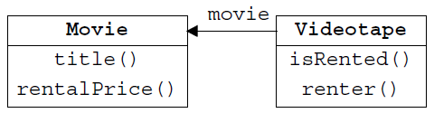
Solution (I)
Class− based object languages give support for instances of classes, but they do not give support for instances of instances of classes.
So to implement this solution in a typical class−based language, you need to implement two classes: one to represent a type of videotape (Movie) and one to represent a videotape (Videotape).
Each instance of Videotape would have a pointer to its corresponding instance of Movie.

Slide 12
Solution (II)
This class diagram illustrates how each instance of Videotape has a corresponding instance of Movie.
It shows how properties defined by the type of videotape are separated from those which differ for each particular videotape.
In this case, the movie’s title and how much is costs to rent are separated from whether the tape is rented and who is currently renting it.

Slide 13
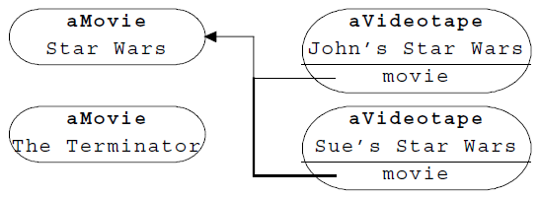
Solution (III)
This instance diagram shows how there is an instance of Movie to represent each type of videotape and an instance of Videotape to represent each video the store stocks.
Star Wars and The Terminator are movies; videotapes are the copy of Star Wars that John is renting verses the one that Sue is renting.
It also shows how each Videotape knows what type it is because of its relationship to a particular instance of Movie.

Slide 14
Handling New Movie
If a new movie, such as Independence Day, were to be rented to Jack, the system would create a new Movie and a new Videotape that points to the Movie.
The movie is Independence Day and the tape is the copy of Independence Day that Jack ends up renting.

Slide 15

Thank You & See You Again

